Slide 1
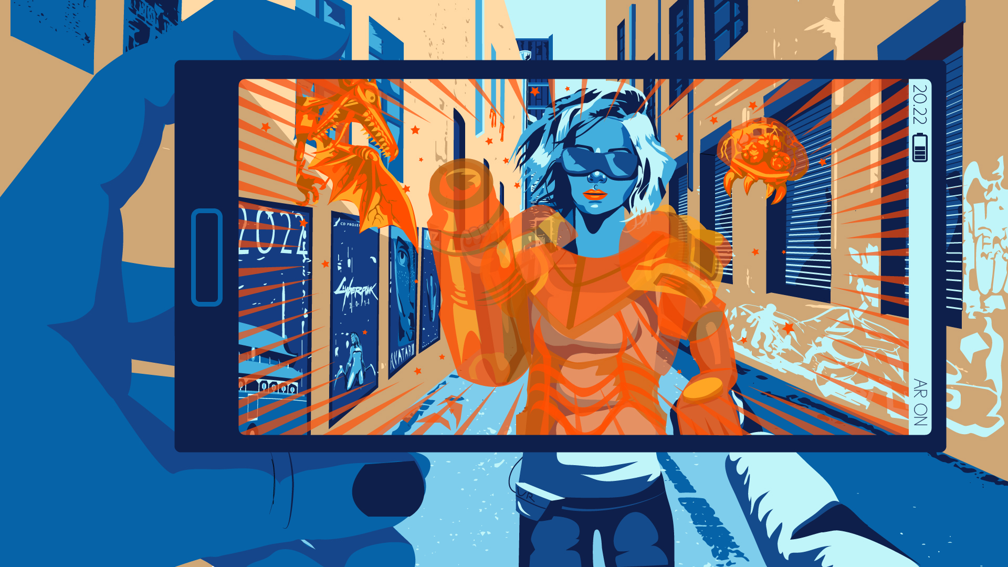
Overview:
What will the game industry look like in five years?
Stafford (2017)
Nicholas Chong
Notes:
Greet everyone, introduce myself
Will be presenting the state of the game industry in 5 years
Presentation based off an article in 2017 BUT
Reason why we should care:
All of us are doing an IT degree or presumably working in the IT field
Every industry related to IT experiences rapid change
Giving you a preview of some changes

Slide 2
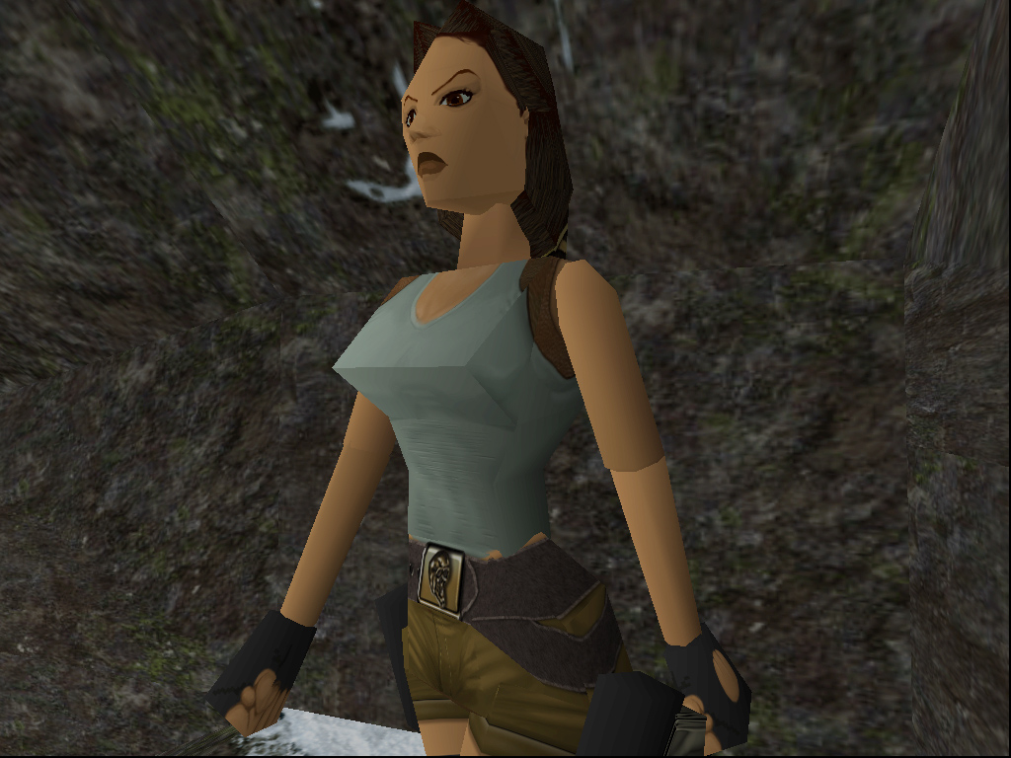

Then vs. Now
King (2016)
SuWalls (2014)
Notes:
An example
Lara Croft in 1996, not much to say…
Lara Croft in 2015, clear difference in how games were in the 90s and now

Slide 3
Presentation Structure
Conclusion
ARTICLE ANALYSIS
Article’s main points
ABOUT THE AUTHOR AND ARTICLE
INTRO

Slide 4

Article Introduction
Written in late 2017 by Patrick Stafford
Article about:
State of game industry in 5 years (2022)
Summarised into:
The Player’s Perspective
The Corporate Perspective
Stafford (Unknown)
Notes:
Written in November 2017 by Patrick Stafford
Article here features the state of the game industry in 5 years (so 2022)
Decides to do this by asking a number of experts in the game industry what their thoughts were
Original article had 5 main points → I will summarise them into 2 key aspects
The Player’s Perspective
The Developer’s Perspective

Slide 5
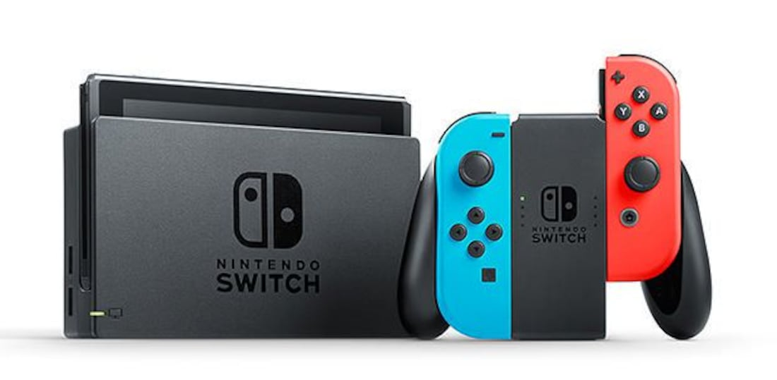
The Player’s Perspective
The non-emergence of virtual reality (VR)
More creative approaches in the future
The biggest dilemma: Finding good content
A future solution is needed
Average player age is increasing
Games made for any age, disability or impediment
Target (2017)
Notes:
VR will not be as big as expected
Reasons of players not always playing video games to be in an alternate world
Significant as VR is what people imagine as the future of gaming
The game industry will not play it safe when it comes to new technology
More creative hardware approaches in the future
e.g. Nintendo Switch redefines portability for games, can play handheld or docked to the TV
Making games has a low barrier of entry with tools like Unity and Gamemaker
Biggest problem stated from each and every developer
"How players will find good content"
Vanaman, “There will be new types of stories told by new types of people, but the games will be harder to find in a sea of content"
Goes so far as saying "discovery after death" will be common occurrence, developer's games discovered by players after their death
Problem to be solved going into the future
Average player age for gaming will increase further into the future, more people playing games towards their 30s
Result: Will see more games designed for any age, disability or any impediment

Slide 6
The Corporate Perspective
Changes over management of developers
Smaller studios
Different cities with different approaches
More data-driven insights
More data scientists and people from non-gaming backgrounds
So many possible changes
Up to the mercy of the world
Notes:
Industry will have changes over management of developers in high profile companies
Industry will have two risks: burnout and talent drain
Game companies today are ok with using developers in 20s and 30s → Burning them out → Letting them go
Result:
Developers starting smaller studios
Different cities with different approaches to managing their developers
Will be case of “which area do you want to work in”
Result of early access development
Allows players to test drive games and provide feedback to developer
Yee believes that there will be more insights from every action that a player can make
Today: Activision testing out tailored microtransactions (in-game payments) based on your gameplay
Riot Games hiring a data analytics team to work on how to reduce toxic player activity
Yee believes more data scientists and other people from non-gaming backgrounds will enter the industry
Summary
Game industry is subject to so many changes, ultimately it is at the mercy of the world that "moves at an increasingly fast pace"

Slide 7
Article Analysis
Stafford is a credible author
Language and tone of the article raises some concerns
Content of the article is valid
Overall: Article is of a high quality
Highly-credible author
Content is still valid to this day
Notes:
Stafford's expertise in the game industry is vast
Writing game articles since 2012
The article was published on Polygon
Gaming website that is semi-exclusive
Need to be able to provide a good closed submission before being a writer
Not everyone can write for Polygon
Stafford is credible for the role of interviewing and transcribing the statements of game industry experts
The language of the article was dealt in a colloquial manner
A lot of gaming jargon (VR, AR, PC, ESL)
A lot of hyperboles that almost sound like an exaggeration
Tried to create a very dramatic tone, to emphasise the excitement all the changes in the game industry
Article was a feature piece for Polygon's 5th anniversary → May be some concern over the contents of the article
In 2019, we see some of the article's predictions taking place
Google Stadia released in 2019
Allows players to watch other player stream video games and then proceed to dive straight into the game
Focuses on the problem of finding good game content as previously mentioned
Overall, the article is of a high quality, backed by a highly-credible author and its content is still valid to this day

Slide 8
Conclusion
Summarised predictions about the game industry
Provided analysis of the article
Change is inevitable and we must prepare for it
Stafford (2017)
Notes:
Summarised the predictions made by Stafford
Regarding the state of the game industry in 5 years
Split into the player’s perspective and the corporate perspective
Higher level analysis of the quality of the article
Can see from countless predictions about game industry
Small subset of IT in general
No matter what we’re doing in the world, change is inevitable
And the article teaches us to both predict and embrace changes in the future
Thank you

